Slide 1

Egypt Center Overview
December 2022

Slide 2


Egypt Center Overview Rapidly scaling up the support
Monthly Hours Billed
Workflow Breakup by Language (YTD)
Number of Employees: One in Jan 2022, Two from Feb- Sep 2022, Four starting Oct 2022
Workflow Breakup by Requestor’s Country (YTD, Hours)
Workflow Breakup by Practice Area (YTD)

Slide 3

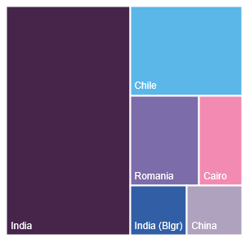
Workflow emerged from Middle East clients (Jan- Dec 2022)
From Jan-Dec 2022, TMT, Public Sector, and Consumer goods emerged as top focus areas
The total volume of work coming from ME clients till December 2022 was 7757.25 hours.
As our focus is on Deploying digital maturity, tourism, and packaged goods, strategically towards smart cities moving forward in 2030 the work which has been received from ME clients is Significant for our current growth.
Direct KPO has received work across cohorts, including, Partners, Principals, Managers, Consultants, and Associates.
India and Chile center has executed most of the research requests, followed. by Romania and Egypt “as Egypt Centre is currently in its developing stage and will take some time to level with other Centers.
Total Volume of Hours – Jan- Dec 2022
Top ME requestors with Cohort Jan- Dec 2022
Top 5 Practice Areas by volume Jan- Dec 2022
Centre wise work volume Jan- Dec 2022
683
Hours
2853.5
413.5
225
Romania
China
129
Notes:
ESG on the Ground: https://flow.db.com/more/macro-and-markets/esg-on-the-ground
ESG at the centre of business strategy: https://www.youtube.com/watch?v=Kps_f_6rluE
https://home.kpmg/xx/en/home/insights/2020/05/creating-trust-in-esg-data.html
https://www.jpmorgan.com/global/technology/blockchain
https://thefinancialbrand.com/104418/digital-banking-transformation-priorities-trends-predictions/
https://www.forbes.com/sites/ronshevlin/2021/01/18/the-5-hottest-technologies-in-banking-for-2021/?sh=4a1825f435c4

